Slide 1
Browser Automation and Python
Michael O’Hanlon & Aughdon Breslin

Slide 2
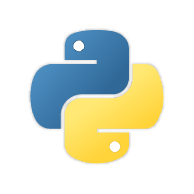
Initial Plans
Learn how to code in Python
Create something with Python just to explore its methods/syntax
Use acquired knowledge to automate a web browser
We figured being able to type without typing was really cool and we could strive to do some basic operations automatically

Slide 3
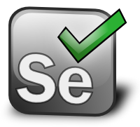
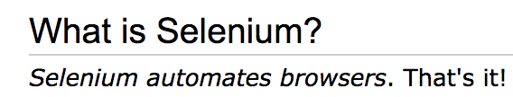
Learning the Basics
YouTube Tutorials on how to use Python
We had no idea how to even start automating a browser, so praise be
Browser Automation research -> Selenium
Seemed simple enough, especially with the program’s description:

Slide 4

The Download Process
Python 3.7.1 (and Python 2.7.14)
PyCharm IDE
chromedriver

Slide 5

The Error Plague
Everything went wrong!
Every tutorial on the face of the earth used the command prompt we didn’t have access to
Switched to a new computer
Chromedriver needs to be in “PATH”
Connection errors
Seemingly impossible to get around

Slide 6
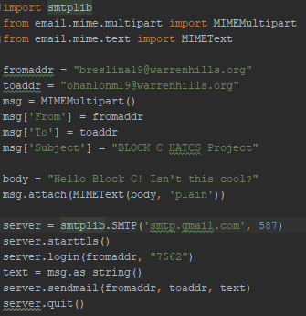
The Backup Plan
We still wanted to get something out of this project, so we looked into automated stuff without using the command prompt
Sending emails automatically!
However there were a few more technical lines
smtplib.SMTP() and .startls()
We weren’t entirely sure what they did

Slide 7
Completing Our Mission (but with Java)
We didn’t want to completely give up on the automated browser idea yet. Despite it being day 8, we were blessed by the Detrick himself and received a 9th day, so we had 1 & 1/2 days to work on it still
We created a package for Selenium, and updated the build path to use the Selenium JARs.
We began our endeavours by creating a simple program to open Google Chrome and search something on Google, and it worked on our first try.
After that success, we began making a more advanced program to login to Gmail.

Slide 8
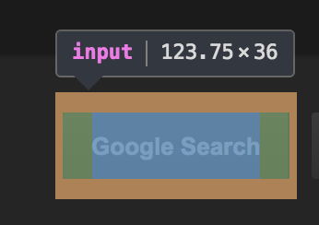
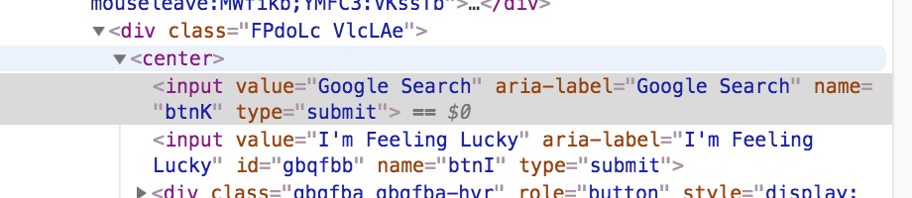
Automating Browsers, the Clutch-Up
Using the wizardry that is Inspect Element, we were able to access page after page, icon by icon, automatic click by automatic click
Who would’ve thought
the search button
for Google
is named “btnK”
Searching by id, name, class, literally anything unique to the thing we wanted

Slide 9
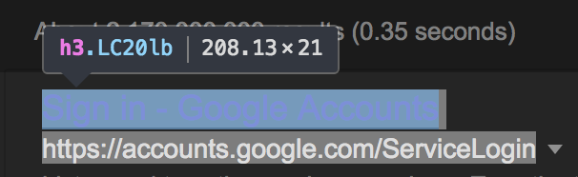
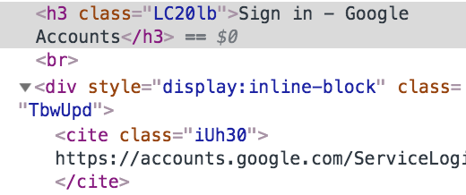
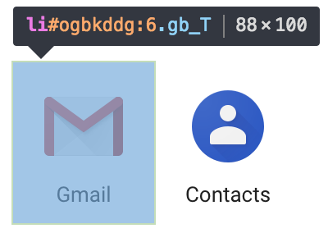
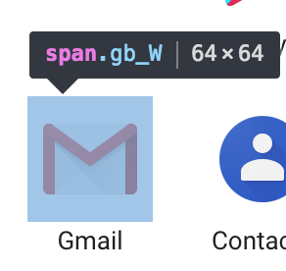
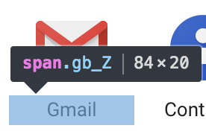
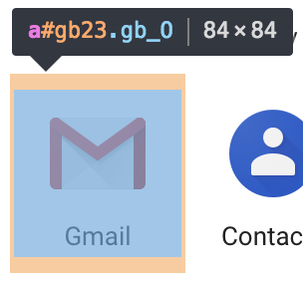
There’s also plenty of opportunities to select the wrong ids! Only one of these actually selects Gmail...

Slide 10
After all of the tediousness,
We reached our inbox!
We sent the email from our Python script, and, starting at the desktop, were able to login to our Gmail account and select the email from our inbox using our Java code!
(Only problem is that the ID of the top email constantly switches from :2d to :2c, so it’s a slight 50/50 as to whether we open the top email or an email about 5 down)

Slide 11
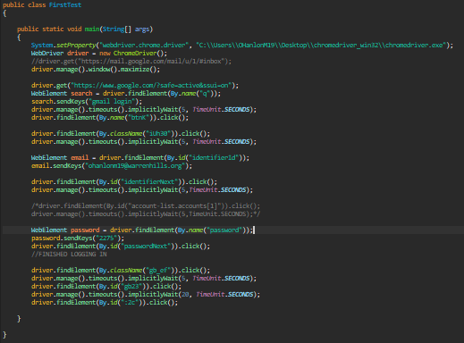
Full Code
Sending the email
Sadfa Automating the Browser

